Slide 1

US COFFEE CHAIN CASE STUDY
A VISUALIZATION project by Pratik Samanta

Slide 2
Table of Contents
Case Details
01
Problem Statement
02
Objectives
03
Things to Consider
04
Data Analysis
05
Dashboard With Actionable Filters
06

Slide 3
Case Details
TOC
This case study consists of 3 tables.
‘Fact Table’ table consists of Area Code, Date, Product ID, budgeted & actual COGS, Margin, Profit, Sales, Marketing cost & total expense details of the coffee chain.
‘Location’ table contains the Market, Market Size, State, Area Code.
‘Product’ table consists of product details of the coffee chain.
Next

Slide 4

Problem Statement
TOC
We need to compare the Budget Sales and Budget Profit with Actual Sales and Profit.
Need to create Top N parameter to find top state based on Profit/Sales for Major market size.
What is the percentage of sales contribution of Central Market in both Major and Small Market?
How is the Marketing cost corelated to Sales? Give the equation.
Which area codes in California have sales more than 6000? Create a visual distinction between these codes and others.
Need to show market wise sales on geographical map. Which market has the highest sales.
Which are the Top 2 and Bottom 2 states in terms of profit? Show using a geographical map.
Next

Slide 5


Objectives
TOC
Analyse the coffee chain’s performance for the given problem statements
Communicate the findings based on data analysis in Tableau
Next

Slide 6
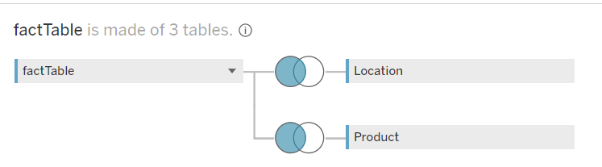
Things to Consider
TOC
We have imported the data from a MS Access database
We have created two left join by using
Fact Table & Location table
Fact Table & Product table
Next

Slide 7
Data Analysis
TOC
Next

Slide 8
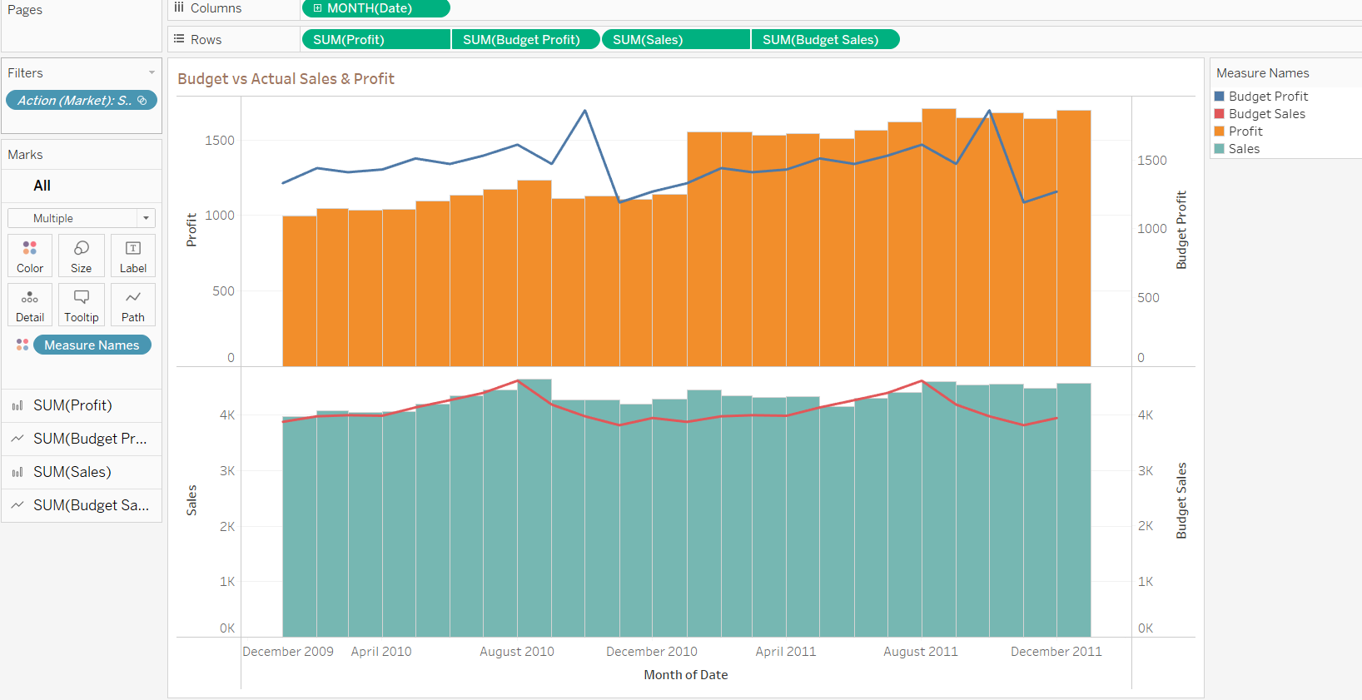
Problem Statement:
Compare the Budget Sales and Budget Profit with Actual Sales and Profit
TOC
Next

Slide 9
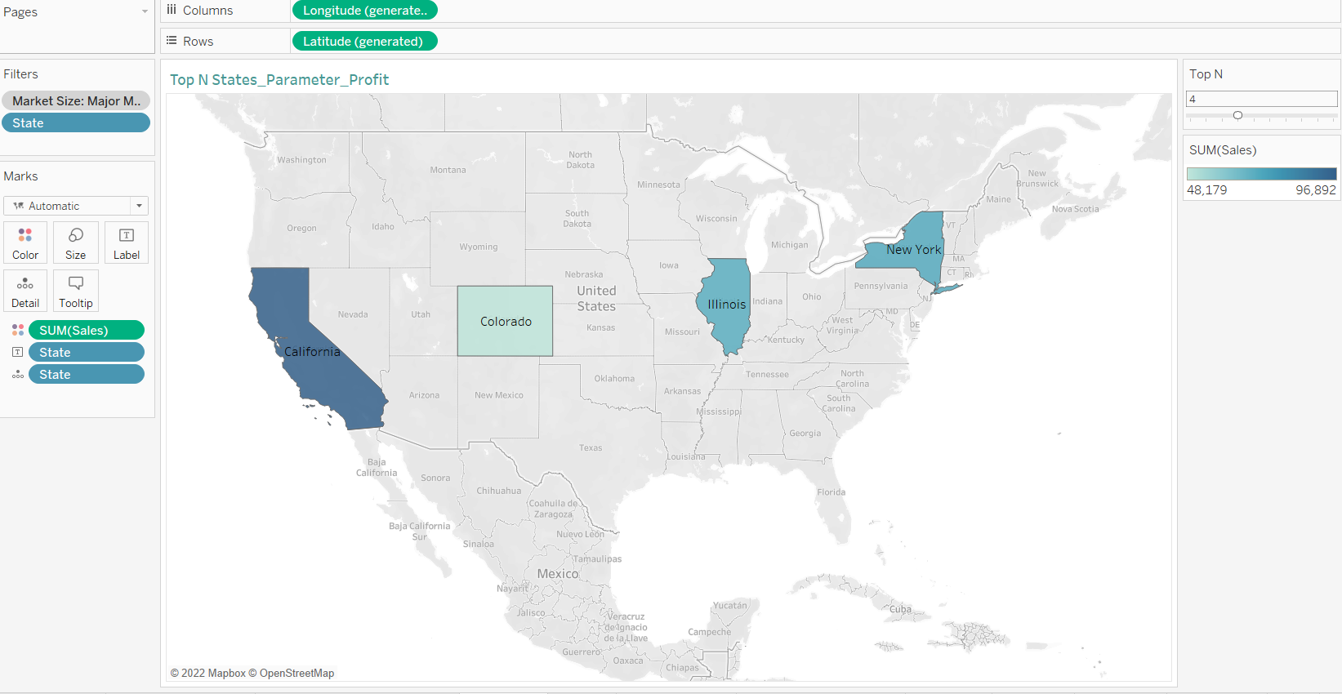
Problem Statement:
Create Top N parameter to find top state based on Profit/Sales for Major market size.
TOC
Next

Slide 10
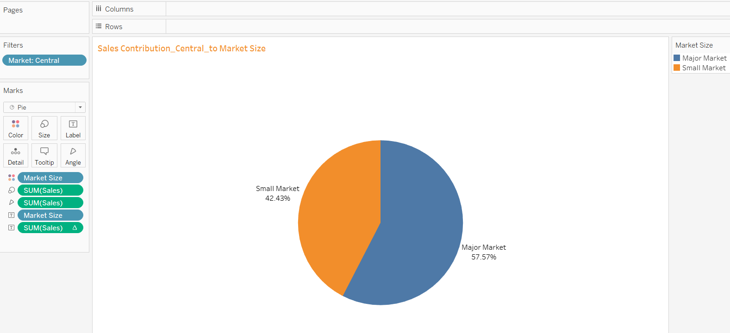
Problem Statement:
What is the percentage of sales contribution of Central Market in both Major and Small Market?
TOC
Next

Slide 11
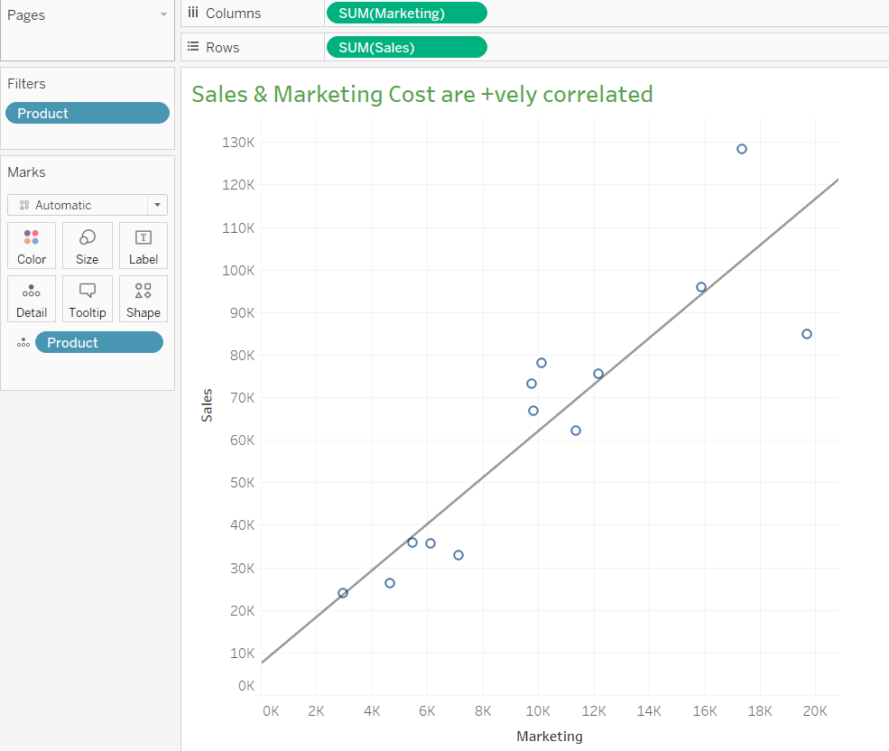
Problem Statement:
How is the Marketing cost corelated to Sales? Give the equation.
TOC
Equation:
Sales = 5.46*Marketing Cost + 7408.7
Next

Slide 12
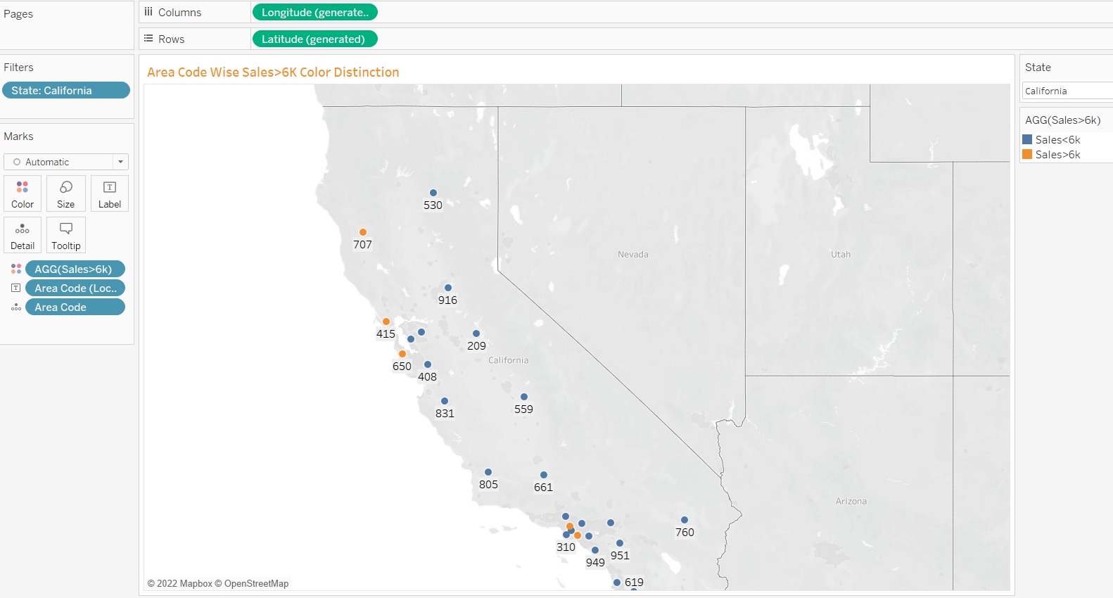
Problem Statement:
Which area codes in California have sales more than 6000? Create a visual distinction between these codes and others.
TOC
Next

Slide 13
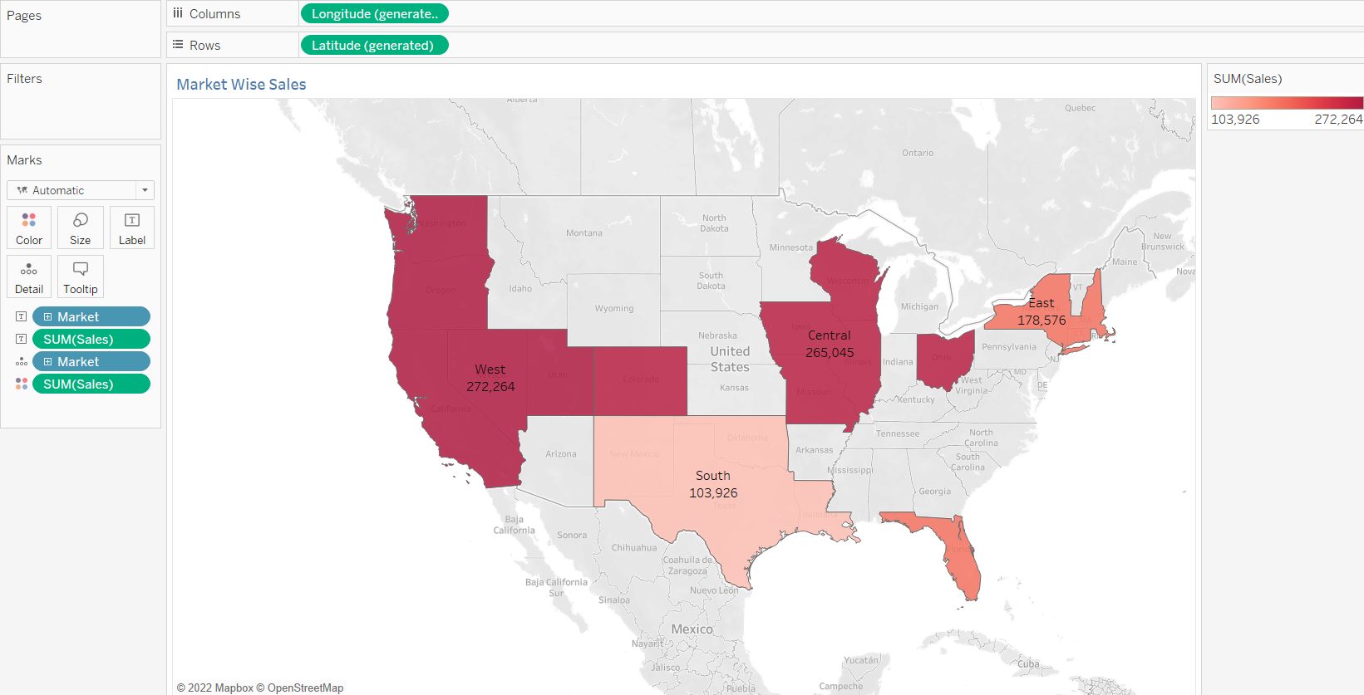
Problem Statement:
Need to show market wise sales on geographical map. Which market has the highest sales.
TOC
Highest Sales: West US Market with a sales figure of 272k USD
Next

Slide 14
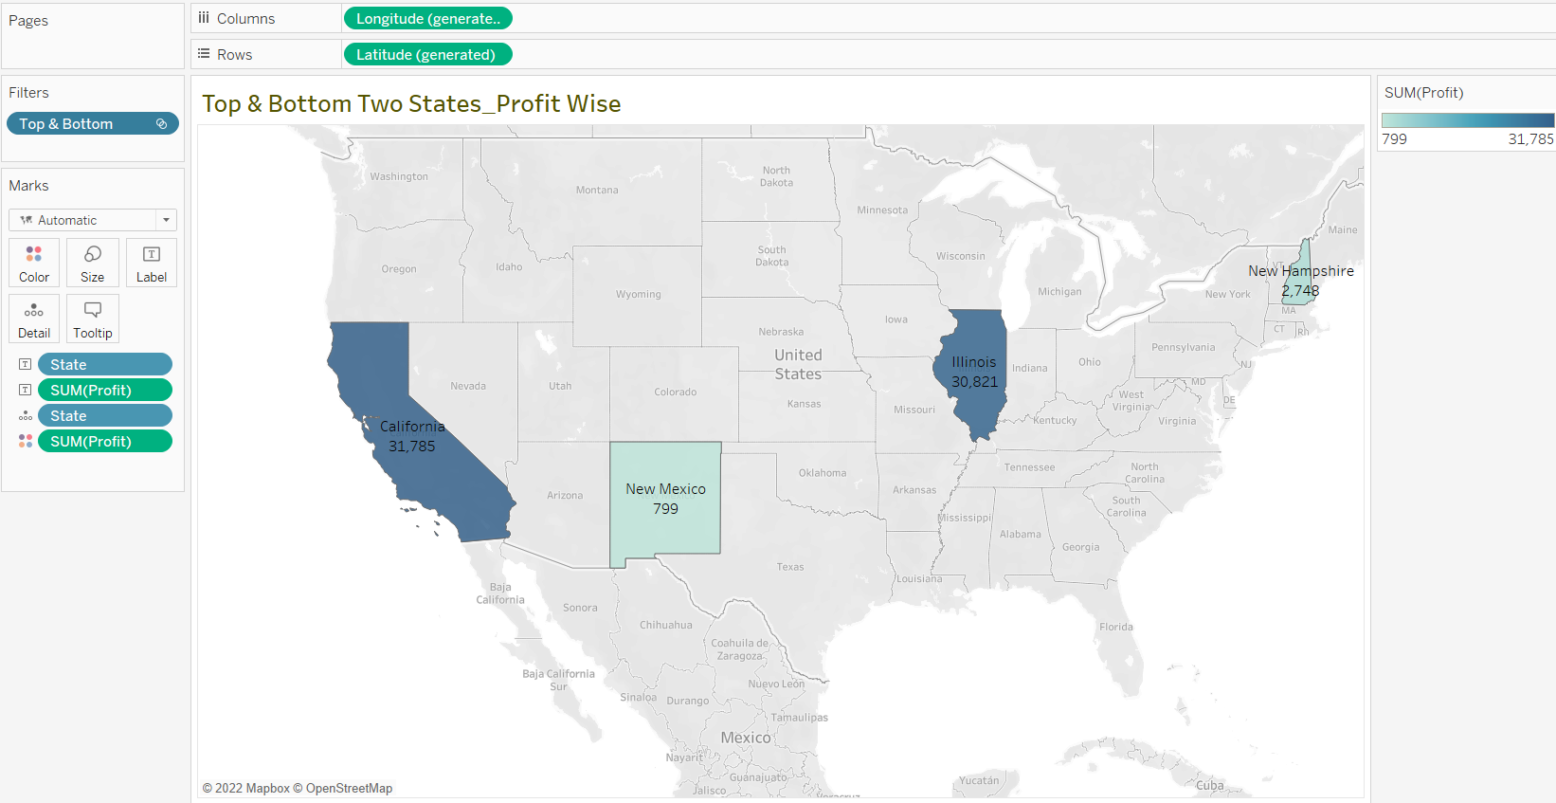
Problem Statement:
Which are the Top 2 and Bottom 2 states in terms of profit? Show using a geographical map.
TOC
Top 2 States: California & Illinois
Bottom 2 States: New Mexico & New Hampshire
Next

Slide 15
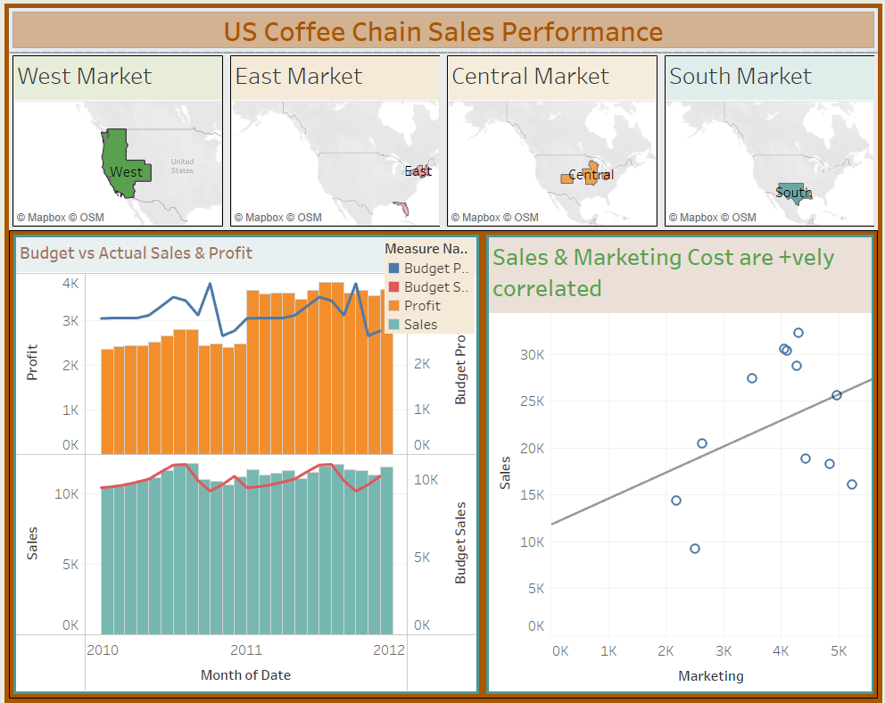
TOC
Dashboard with Market Wise Actionable Filters
Next

Slide 16



